Slide 1
Introduction to SQL: Structured Query Language By AppJedi
Day Two

Slide 2
Review Syllabus.
Goals:
Basic SELECT statement for data retrieval.
Where clause filter rows.
Using wild cards.
Specifying columns and column aliases.
Order by (Sorting).
Limiting number of rows.
SQL Operators: Arithmetic, Comparison, Logical
SQL Null Functions:
Set Operations: UNION, UNION ALL, INTERSECT, EXCEPT
Aggregates: COUNT, SUM, AVG, MIN, MAX.
Group By and Having (filter).
Sub queries.
Joins: INNER, LEFT, RIGHT, OUTER.
Temp tables (with)
CASE statements.
Views.
Date functions.
String functions.
Numeric functions.

Slide 3
SQL Comparison Operator
= Equal to
> Greater than
< Less than
>= Greater than or equal to
<= Less than or equal to
<> Not Equal to.

Slide 4
SQL =
SELECT * FROM products
WHERE type=‘simple’
SELECT * FROM products
WHERE RegularPrice>10;
SELECT * FROM products
WHERE RegularPrice<10;

Slide 5
SQL Logical Operators
BETWEEN
IN
NOT IN
ANY – works the same as IN
ALL - Doesn’t appear to be supported by Big Query.
EXISTS

Slide 6
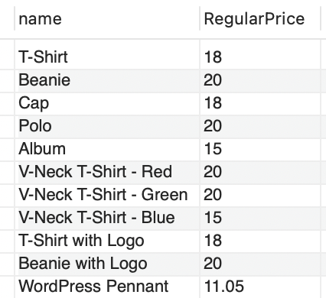
BETWEEN
The BETWEEN operator selects values within a given range. The values can be numbers, text, or dates.
The BETWEEN operator is inclusive: begin and end values are included.
SELECT name, RegularPrice FROM products
WHERE RegularPrice BETWEEN 10 AND 20;

Slide 7
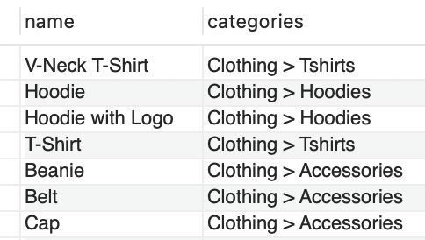
IN
The IN operator allows you to specify multiple values in a WHERE clause.
The IN operator is a shorthand for multiple OR conditions.
SELECT name, categories FROM appjedin_student_temp.products
WHERE categories
IN ('Clothing > Accessories','Clothing > Hoodies','Clothing > Tshirts');

Slide 8
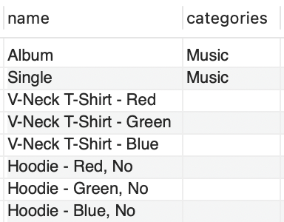
NOT IN
The NOT IN operator allows you to specify multiple values not in a WHERE clause.
The NOT IN operator is a shorthand for multiple OR conditions.
SELECT name, categories FROM appjedin_student_temp.products
WHERE categories
NOT IN ('Clothing > Accessories','Clothing > Hoodies','Clothing > Tshirts');

Slide 9
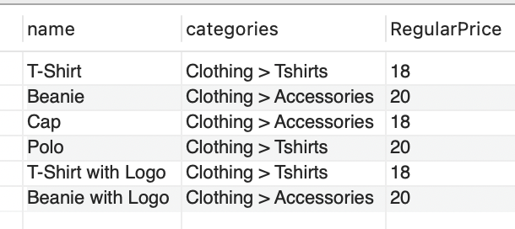
BETWEEN & NOT IN compound condition.
SELECT name, RegularPrice FROM products
WHERE RegularPrice BETWEEN 10 AND 20
AND categories
NOT IN ('Clothing > Accessories','Clothing > Hoodies','Clothing > Tshirts');

Slide 10
EXISTS
The EXISTS operator is used to test for the existence of any record in a subquery.
The EXISTS operator returns TRUE if the subquery returns one or more records.
SELECT * FROM products
WHERE EXISTS(SELECT 1 FROM products WHERE RegularPrice>100)
SELECT * FROM products
WHERE NOT EXISTS(SELECT 1 FROM products WHERE RegularPrice>100)

Slide 11
SQL Arithmetic Operators
+ Addition
- Subtraction
* Multiplication
/ Division
% Modulus

Slide 12
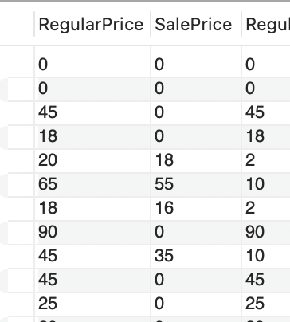
Example: Substraction (-)
SELECT RegularPrice, SalePrice, RegularPrice - SalePrice FROM products;

Slide 13
NULL values & SQL Null Functions:
What is Null?
IFNULL()
IS NULL operator

Slide 14
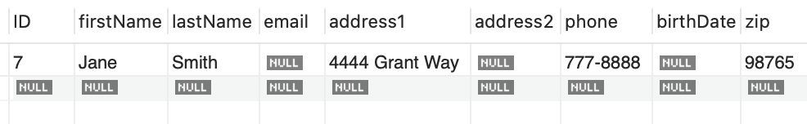
What is a NULL value?
A field with a NULL value is a field with no value.
SELECT * FROM customer WHERE email IS NULL;

Slide 15
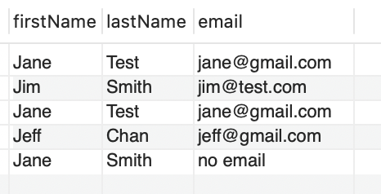
IFNULL (column, default-value)
SELECT firstName,lastName, IFNULL(email,'no email') AS email FROM customer

Slide 16
Set Operations:
UNION ALL
UNION DISTINCT
INTERSECT
EXCEPT

Slide 17
UNION
UNION operator is used to combine the results of two or more SELECT statements.
Every SELECT statement within the UNION must have the same number of columns and they must have compatible data types.
Columns must also be in the same order.

Slide 18
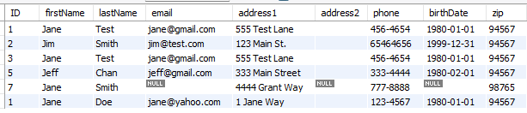
UNION [DISTINCT] Example:
select * from customer
union
select * from customer_new;

Slide 19
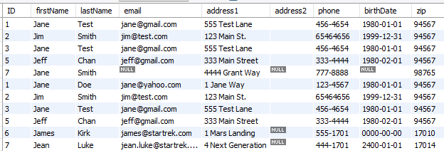
UNION ALL Example:
SELECT * FROM customer
union
SELECT * FROM customer_new;

Slide 20

INTERSECT.
All the rows the two tables have in common.
SELECT firstName, lastName, email, address1, phone, birthDate, zip FROM customer
INTERSECT
SELECT firstName, lastName, email, address1, phone, birthDate, zip FROM customer_new;

Slide 21

EXCEPT.
The EXCEPT operator in SQL is used to retrieve all the unique records from the first query, except the records that are present in the result set of the right operand (query).
SELECT firstName, lastName, email, address1, phone, birthDate, zip FROM customer
EXCEPT
SELECT firstName, lastName, email, address1, phone, birthDate, zip FROM customer_new;

Slide 22

EXCEPT (flip it).
The EXCEPT operator in SQL is used to retrieve all the unique records from the first query, except the records that are present in the result set of the right operand (query).
SELECT firstName, lastName, email, address1, phone, birthDate, zip FROM customer_new
EXCEPT
SELECT firstName, lastName, email, address1, phone, birthDate, zip FROM customer;

Slide 23
Thank you!
Leave your questions in the comment section.
Please like and subscribe to my channel.
Find me online at www.appjedi.net

